Slide 1
We Are technology
The Four Amazing Fields
of Realtime Reporting

Slide 2
Texting language
BTW
FYI
LOL
TMI
B4N
BFF
JK
By the way
For your information
Laugh out loud
Too much information
Bye for now
Best friends forever
Just kidding
© 2012, MAPCR All rights reserved.

Slide 3
steno language
PWEUT/WAEU – by the way
TPOR/KWRUR/TPH-FRGS – for your information
HRAF/OUT/HROUD – laugh out loud
TAOFP/TPH-FRGS – too much information
PWAO*EU/TPOR/TPHOU – bye for now
PW*ES/TPREPBDZ/TPOEFR – best friends forever
SKWR*US/KEUD/-G – just kidding
© 2012, MAPCR All rights reserved.

Slide 4
Can you imagine…
Typing at 225 words per minute?
Realtime reporters graduate at 225 wpm and type upwards of 260 wpm… on a steno keyboard!
© 2012, MAPCR All rights reserved.

Slide 5
We Are technology
© 2012, MAPCR All rights reserved.

Slide 6
© 2012, MAPCR All rights reserved.

Slide 7
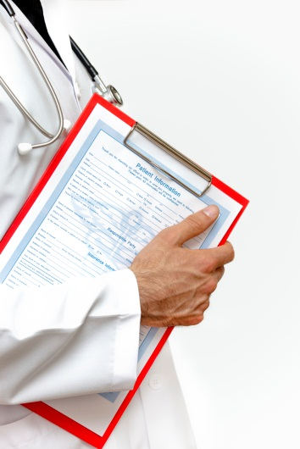
Freelance court reporting
Law office, deposition room, or medical office
Realtime translation is immediately viewable
Captures every spoken word and produces a transcript
© 2012, MAPCR All rights reserved.

Slide 8
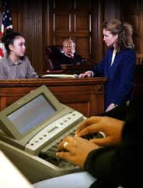
Official court reporting
Employee of the court – courtroom setting
Realtime translation is immediately viewable
Captures every spoken word and produces a transcript
© 2012, MAPCR All rights reserved.

Slide 9
CART Reporting
Communication Access Realtime Translation
On-site or remote
Live event translation for people with hearing loss; school, meetings, appointments, etc.
Equal access to information
© 2012, MAPCR All rights reserved.

Slide 10
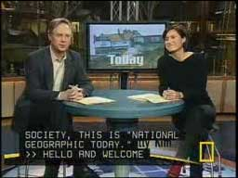
Broadcast captioning
Home office or on-site
English text for live television; sports, news, live events
Captions travel via modem or web to appear on TV
All programming is required to have captions to comply with the ADA
© 2012, MAPCR All rights reserved.

Slide 11
Youtube video
Go to YouTube and Search MAPCR and watch the “We Are Technology” video
© 2012, MAPCR All rights reserved.

Slide 12
Steno keyboard
© 2012, MAPCR All rights reserved.

Slide 13
The steno keyboard
Was invented in 1863
Key difference from QWERTY – multiple keys can be pressed down at the same time
Write phonetically by syllables and with brief forms
© 2012, MAPCR All rights reserved.

Slide 14
Steno alphabet – left side
B- = PW
C- = KR
D- = TK
F- = TP
G- = TKPW
J- = SKWR
L- = HR
M- = PH
N- = TPH
Q- = KW
V- = SR
X- = KP
Y- = KWR
Z- = SKP
© 2012, MAPCR All rights reserved.

Slide 15
Steno vowel sounds
A = short sound
AEU = long sound
E = short sound
AOE = long sound
EU = short i sound
AOEU = long i sound
O = short sound
OE = long sound
U = short u sound
AOU = long u sound
© 2012, MAPCR All rights reserved.

Slide 16
Steno alphabet – right side
-C = BG
-J = PBLG
-K – BG
-M = -PL
-N = PB
-V = *F
© 2012, MAPCR All rights reserved.

Slide 17
STENO OUTLINES
PW*URP - burden of proof
KWRA*RD – beyond a reasonable doubt
PWOEBL – Barnes & Noble
K-BG – Krispy Kreme
PHR-BG – Martin Luther King, Jr.
PWRO*EPL – Barack Obama
© 2012, MAPCR All rights reserved.

Slide 18
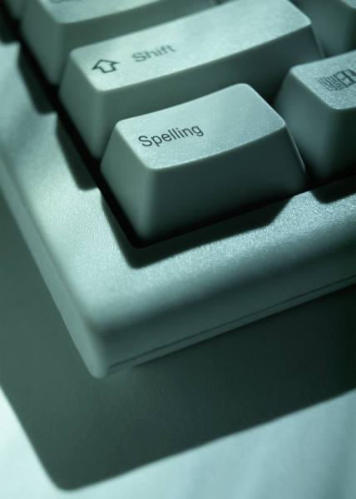
Helpful skills from the start
Typing skills
English and spelling skills
Vocabulary knowledge
Comfortable with technology, computers, and software
Communication skills
© 2012, MAPCR All rights reserved.

Slide 19
schooling
Average time is 18 to 36 months
Brick and mortar schools or online programs
www.ncra.org
© 2012, MAPCR All rights reserved.

Slide 20
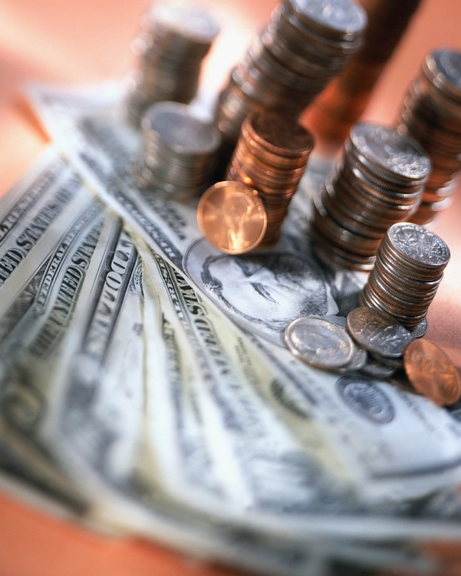
Realtime reporting income
I.C. vs. employees
Official reporters – salary, benefits and transcript fees
Freelance - paid by the hour and transcript fees
CART & captioners – paid by the hour
Average salary is $62,000/year
© 2012, MAPCR All rights reserved.

Slide 21
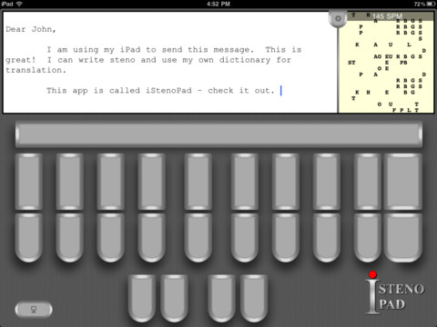
Check it out!
iStenoPad is a Steno keyboard app for your iPad!
Instant Realtime Translation
Writing Speed Display (strokes per minute)
© 2012, MAPCR All rights reserved.

Slide 22
Questions?
Contact NCRA at www.ncra.org
Contact MAPCR at www.mapcr.org
© 2012, MAPCR All rights reserved.

